Slide 1
Aortic Valve Replacement
Tokyo Women’s Medical University
Cardiovascular Surgery Department
Hiroyuki Tsukui

Slide 2
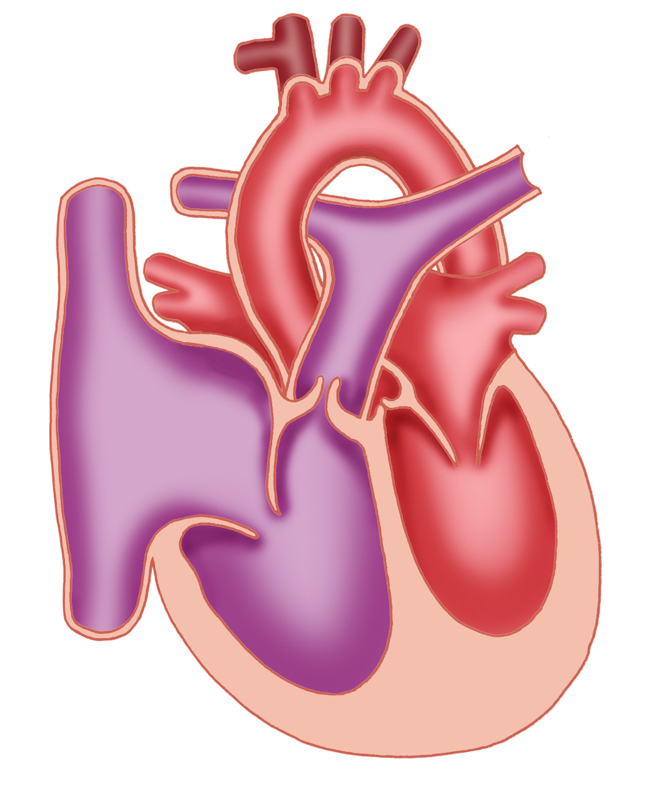
Aortic Valve
Aorta
Pulmonary Artery
Left Atrium
Right Atrium
Left Ventricle
Right Ventricle
A valve between the left ventricle and the aorta
It has a role to flow the blood in one direction
A normal aortic valve has the size of 2-3 square centimeters when open.

Slide 3
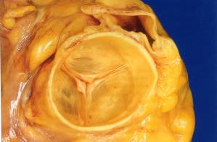
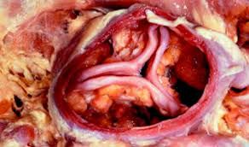
Aortic Valve Stenosis
Normal aortic valve
Aortic valve stenosis
Calcification is prominent

Slide 4
Natural Prognosis of Patients with Aortic Valve Stenosis
Appearance of severe subjective symptoms
Asymptomatic period
(Progression of stenosis, Myocardial overload)
Angina
Faint
Survival rate (%)
Heart
failure
Average survival
period (years)
Average age of death
Age (years)

Slide 5
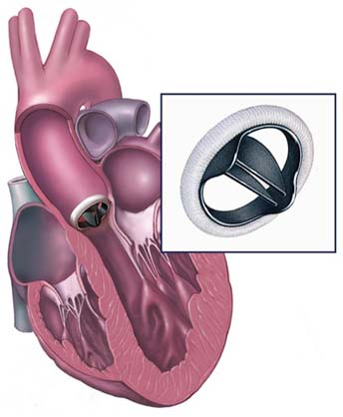
Aortic Valve Replacement
Remove the patient’s own valve and implant an artificial valve.

Slide 6
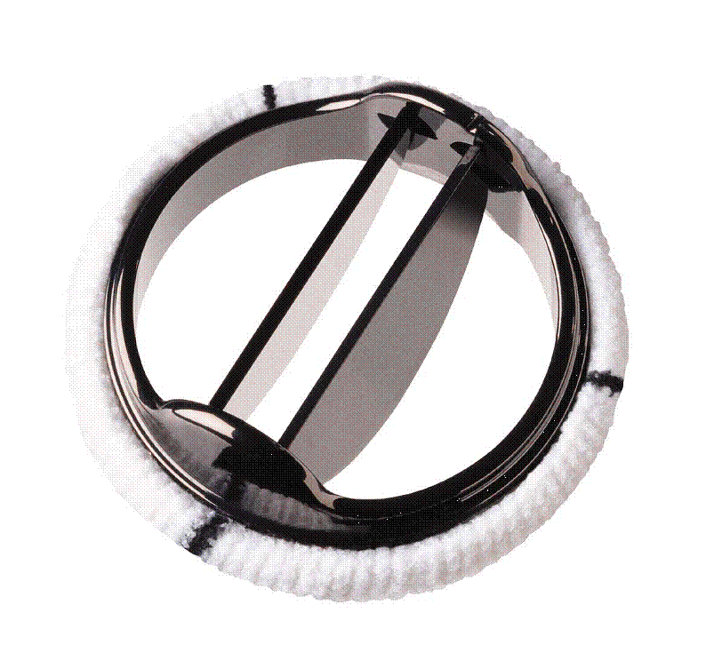
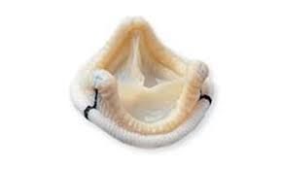
Types and Characteristics of Artificial Valves
Mechanical
Valve
Biological
Valve
Merit
Excellent durability
Anticoagulation therapy (warfarin) can be discontinued.（*）
長
所
Demerit
Anticoagulation therapy (warfarin) must be continued for life.
Durability is limited (10-15 years) and may require re-replacement.
* However, anticoagulation therapy is required if there is atrial fibrillation.

Slide 7
Choice of Artificial Valves
Age
Under 65-yr old
Over 65-yr old
Patients without risk factors for thromboembolism.
Anticoagulation therapy is possible.
Anticoagulation therapy is not possible, or when a biological valve is selected after a detailed discussion of the risks of anticoagulation therapy and future reoperation.
Mechanical
Valve
Biological
Valve

Slide 8

Aortic Valve Replacement

